Slide 1
Evernote’s New Era
Challenges proposition
Submitted by :
Samar Ashry
Mary Girgis

Slide 2
Evernote’s Current Situation
Ease of use
Product-market fit was Evernote’s most significant problem
8.9
App Recommendation
96%
Meet Requirement
Failing to deliver the value customers expect from a note-taking app
8.9
User Rating Review
4.4
Customer support
Positive Reviews
87%
Lacking of customer support
8.5
Notes:
https://www.getapp.com/collaboration-software/a/microsoft-onenote/compare/zoho-notebook-vs-evernote-vs-google-keep/
https://www.g2.com/compare/evernote-vs-google-workspace-vs-microsoft-onenote-vs-zoho-notebook
https://www.getapp.com/collaboration-software/a/evernote/

Slide 3
SWOT Analysis
Strengths
S
W
Weaknesses
Plenty of great features
Available on all major platforms
Precise searching options(OCR)
Advanced tools
User Experience
Product market fit problem
Freemium Strategy model
Monthly bandwidth limit
Pricey
value customers expect from a note-taking app
Security & privacy
SWOT
Opportunities
Threats
Advanced tools
Precise searching(OCR)
Available on most platforms
No Issues fixes
Lack of Support
Pricing Model
Hard competition with other note-app competitors
Lack of innovations
O
T

Slide 4
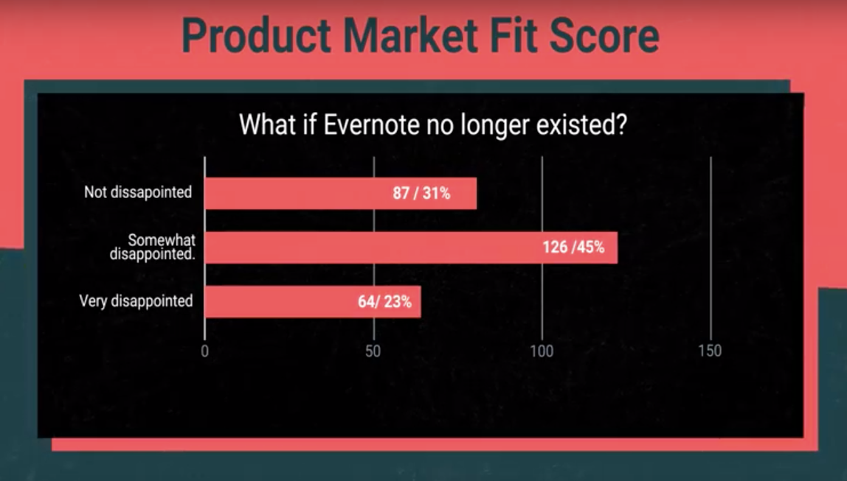
Evernote’s NPS
NPS score 23%, meaning that only 64 of 277 people we surveyed would be disappointed if they could no longer use the service.
Notes:
When we asked customers, How disappointed would you be if you could no longer use Evernote? They received a product-market fit score of 23%, meaning that only 64 of 277 people we surveyed would be disappointed if they could no longer use the service.
What we’re looking for is a threshold of at least 40%. This means that Evernote is not providing the type of value that customers expect from a note-taking app

Slide 5
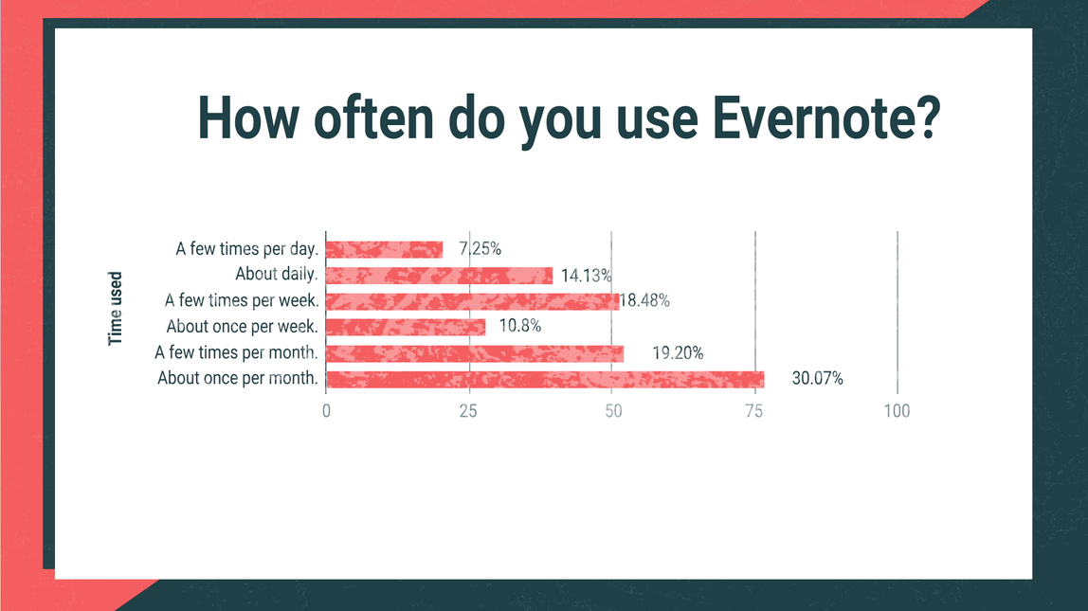
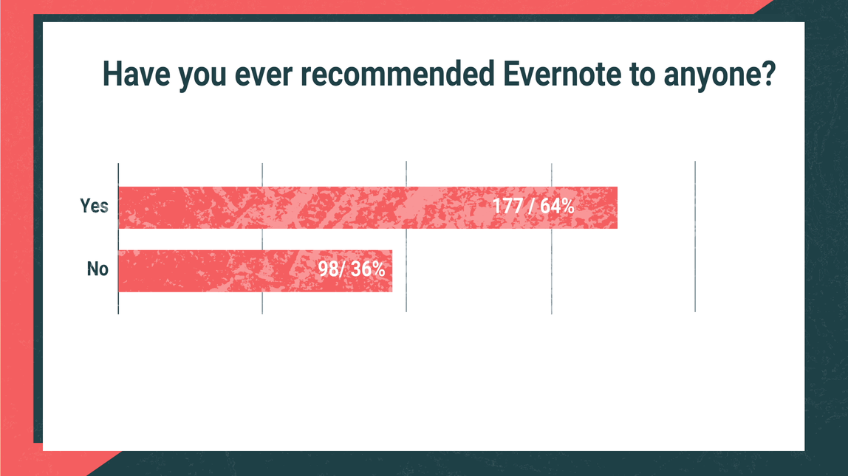
Notes:
As a product that is designed for daily use, we found that only about 25% of Evernote customers use the app every day. That means that when Evernote builds features that appeal to the other 75% of their customers, they can’t capitalize on the diehard fans who really care and are more willing to pay
We’ve mentioned before that Evernote is essentially a daily-use product, but daily users accounted for only 21.38% of responses. That includes people using the app A few times per day and About daily. When you take a look at the survey results, About once per month is the biggest percentage by far, with just over 75 responses.
This lack of engagement could explain the responses to our next question as well, What is the primary benefit you receive from Evernote?
22% said it keeps them organized - “It allows me to organize my notes in one digital place. Evernote allows me to keep everything in journals and organized in a more concise manner.”
12% said ease of use - “The application is simple to use. It’s easy to write and collect my notes.”
11% said syncing across devices - “Being able to take notes and sync it across PC, laptop, and phone.”
When only about 1/5 of your user base say the primary benefit of your note-taking app is staying organized, that’s pretty telling. Combine that with the fact that approximately 1/10 of your customers don’t recognize your core value (syncing across devices) as the primary benefit, and you have a huge problem. Trying to appeal to everyone and not building the functionality that core customers want to use made Evernote’s product feel stagnant, which is definitely a tradeoff they should never have made

Slide 6
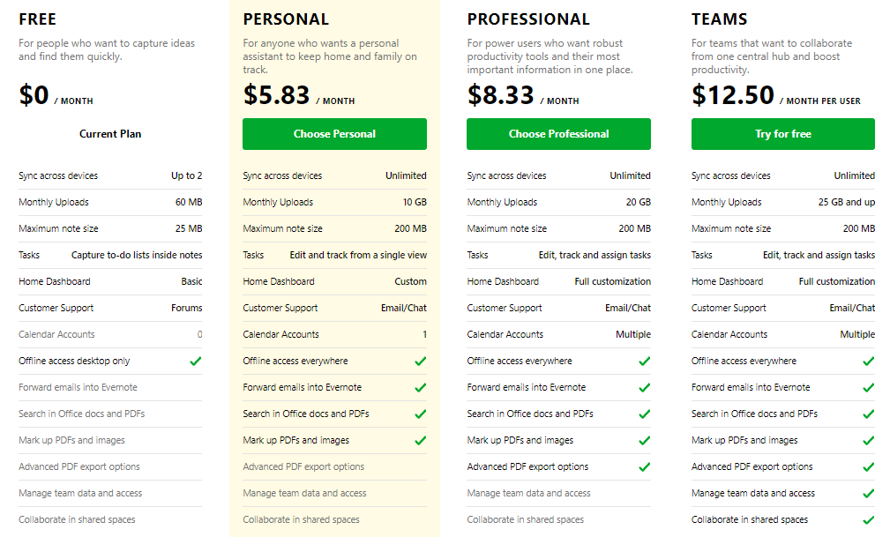
Evernote’s Pricing model
Notes:
https://evernote.com/community/referral/?ebcc=ebcc-anshulkumar3743&gspk=ZWJjYy1hbnNodWxrdW1hcjM3NDM&gsxid=9Zf31lenbY8F

Slide 7









Competitors
Notes:
https://www.getapp.com/collaboration-software/a/evernote/alternatives/
https://hive.com/blog/evernote-alternatives/

Slide 8
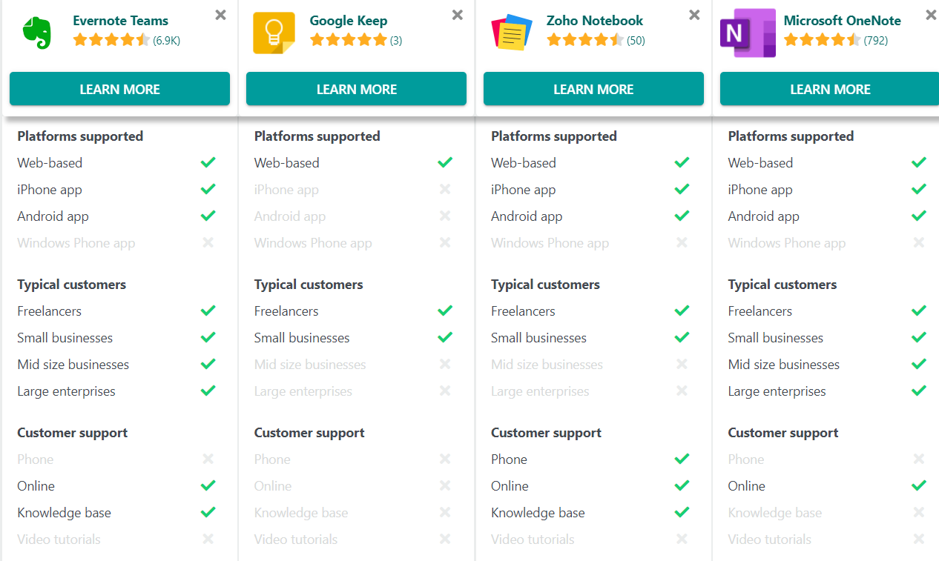
Evernote’s Primary Competitors
Notes:
https://www.getapp.com/collaboration-software/a/microsoft-onenote/compare/zoho-notebook-vs-evernote-vs-google-keep/

Slide 9
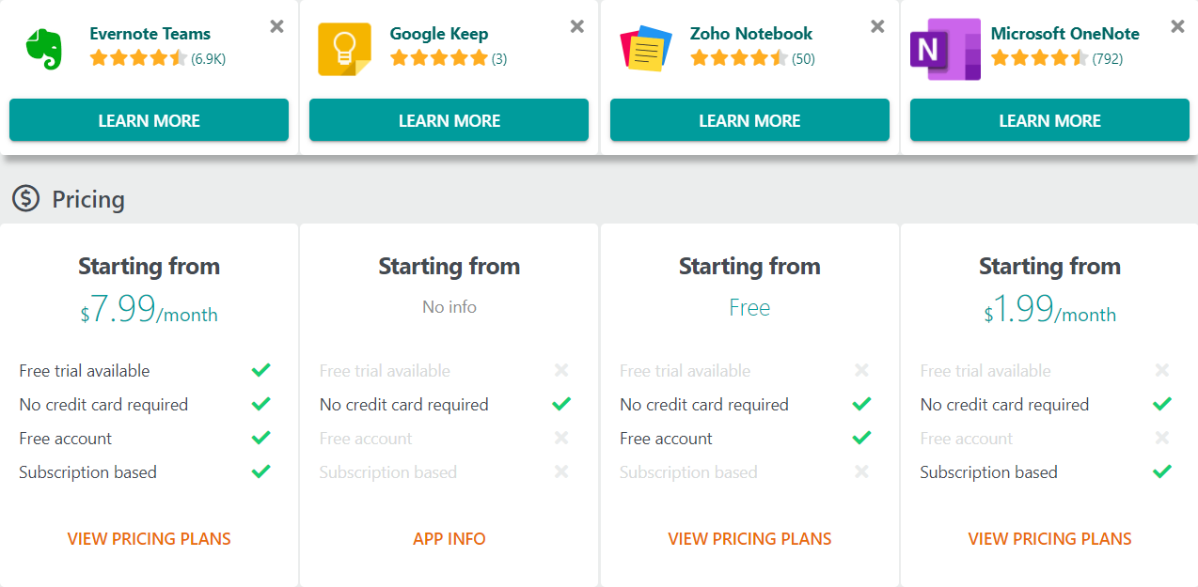
Evernote’s Primary Competitors - Pricing
Notes:
https://www.getapp.com/collaboration-software/a/microsoft-onenote/compare/zoho-notebook-vs-evernote-vs-google-keep/

Slide 10
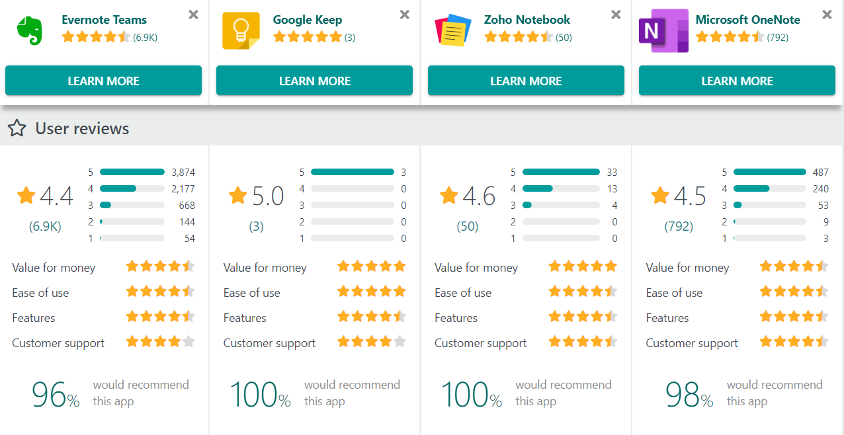
Evernote’s Primary Competitors - User Reviews
Notes:
https://www.getapp.com/collaboration-software/a/microsoft-onenote/compare/zoho-notebook-vs-evernote-vs-google-keep/

Slide 11
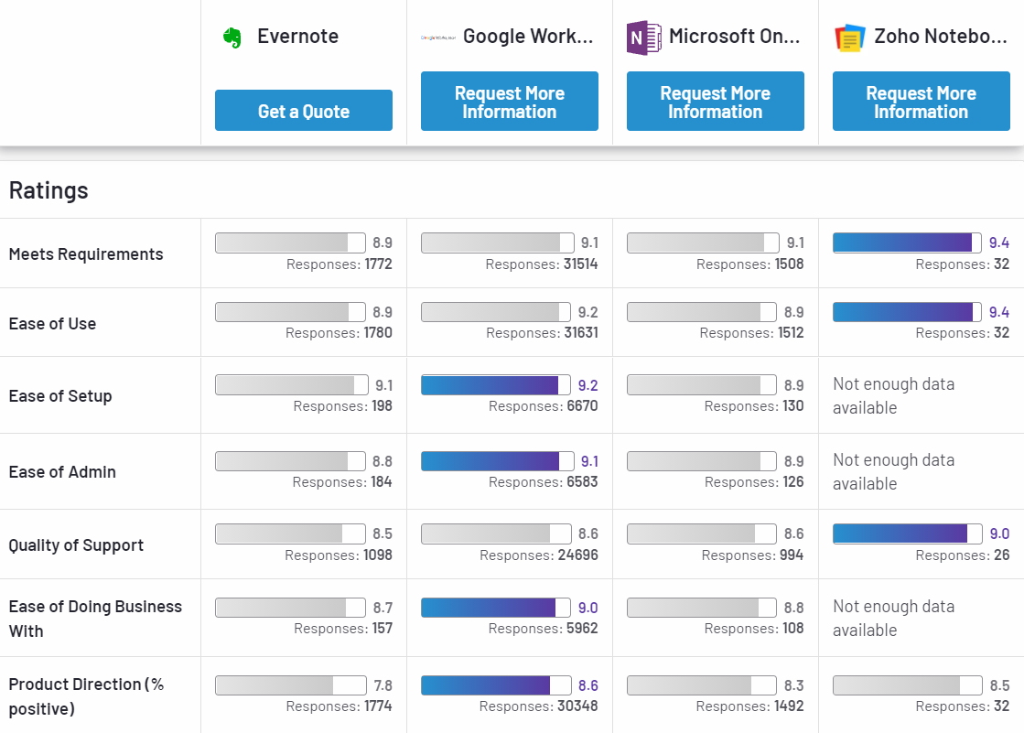
Evernote’s Primary Competitors -Rating
Notes:
https://www.g2.com/compare/evernote-vs-google-workspace-vs-microsoft-onenote-vs-zoho-notebook

Slide 12
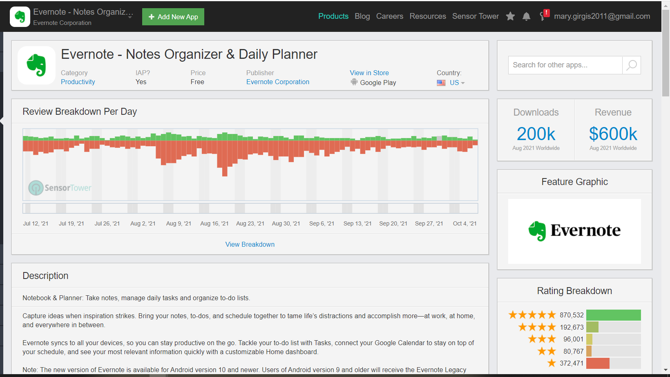
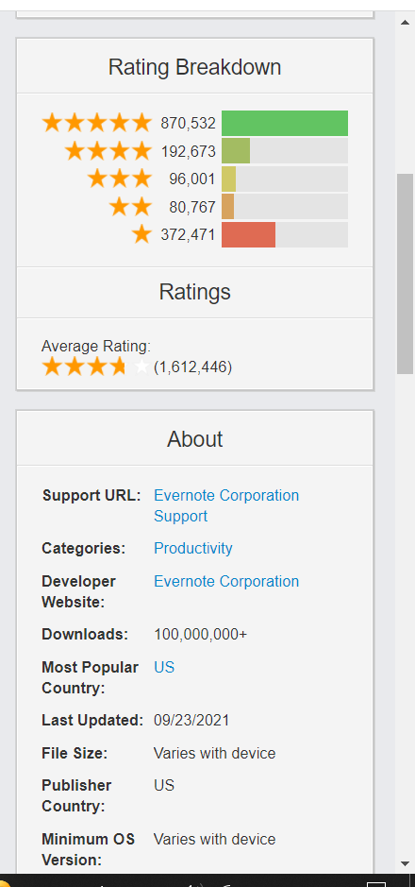
Evernote’s Revenue
Notes:
https://sensortower.com/android/US/evernote-corporation/app/evernote-notes-organizer-daily-planner/com.evernote/overview

Slide 13
Spotted Challenges / Problems
Product Market Fit
Because of the current pricing model, there is a lack of user engagement.
Providing the value that customers expect from a note-taking app
Improved security and privacy
Dedicated to repairing and improving the core Evernote product
Make enhancements to the application infrastructure's core.
Lacking Customer service

Slide 14
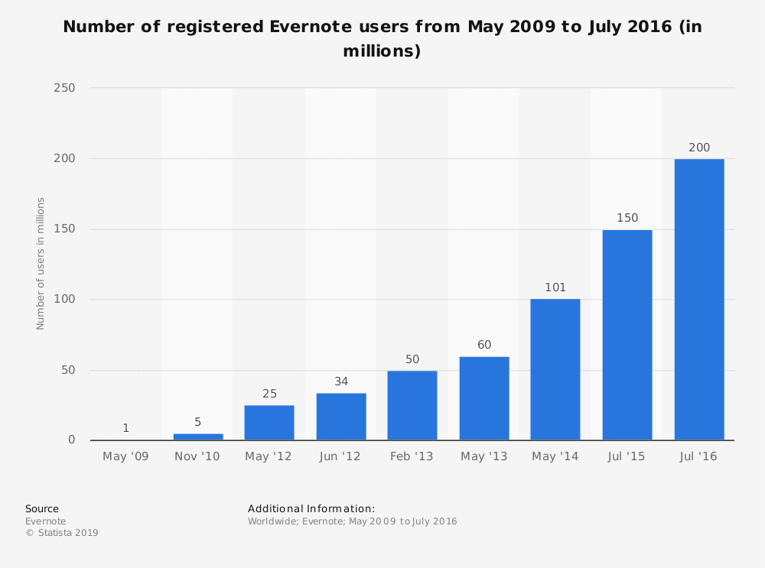
Evernote’s ( Challenge / Problem ) 1
The Root cause behind
Having a product-market fit was Evernote’s most significant problem.
As large as Evernote is, they lack a proper understanding of what their clients require. As a result, although 225M clients have been procured through a solid freemium strategy, they aren’t taking full advantage of them.
Poor product market fit:
The fact that only 25% of the total increasing number of users (225 Million users) uses Evernote daily, reveals that Evernote failed to define a good product market fit. The inability to make the best use out of the customers base says a lot about a company’s business plan and strategy.
Notes:
https://clickup.com/blog/evernote-alternatives/
https://www.youtube.com/watch?v=KBnyayE9Kn0
https://www.profitwell.com/recur/all/evernote-tradeoffs
https://expandedramblings.com/index.php/evernote-statistics/
https://www.helloleads.io/blog/stats-facts/evernote-24-amazing-stats-facts/

Slide 15
Evernote’s ( Challenge / Problem ) 2
The Root cause behind
Lack of engagement
Poor pricing plan:
Evernote launched the company with the logic of a freemium pricing plan, then when they decided to shift to a subscription model; the step was taken aggressively and with no strategic planning. The result is that we have a product that has minimum freemium features and that almost most of the features require payment even before having a free trial period, leading to high churn rate and low NPS.

Slide 16
Evernote’s ( Challenge / Problem ) 3
The Root cause behind
Striving to please everyone, development stagnated, and unfocused features were added, making it more challenging to compete with new services emerging.
Evernote is failing to deliver the value customers expect from a note-taking app.
No competitive edge
It was proved that Evernote’s lateness in taking an initiative that keeps up with its competitors releases and initiatives, led to Evernote being out of competition for so long that actually some younger companies have passed Evernote and achieved more in less years. Also this contributed to Evernote's failure in defining a clear product market fit.
Notes:
https://clickup.com/blog/evernote-alternatives/
https://www.youtube.com/watch?v=KBnyayE9Kn0
https://www.profitwell.com/recur/all/evernote-tradeoffs
https://expandedramblings.com/index.php/evernote-statistics/
https://www.helloleads.io/blog/stats-facts/evernote-24-amazing-stats-facts/

Slide 17
Revisiting Evernote Business Plans & Strategies
Evernote Product Delivery - Value Chain
Evernote adopts the strategy of partnerships and pre-installation agreements for customer acquisition. This leads to huge number of downloads and increase in first time users numbers however it does not guarantee increase in returning customers rate, as Evernote is not depending on directing its product to a certain persona with certain needs.
Evernote Market Segmentation
Evernote considers its targeted segment is anyone having devices and documents to share or organize. A vague wide market segmentation always leads to poor product market fit.
Evernote Business Model
Evernote customer segment do not include students. However, it was proved that university and school students tend to need a note and document holder on daily basis. Accordingly introducing this segment in their canvas would be a plus, adding to their revenue and to Evernote’s number of daily users
Notes:
https://clickup.com/blog/evernote-alternatives/
https://www.youtube.com/watch?v=KBnyayE9Kn0
https://www.profitwell.com/recur/all/evernote-tradeoffs
https://expandedramblings.com/index.php/evernote-statistics/
https://www.helloleads.io/blog/stats-facts/evernote-24-amazing-stats-facts/

Slide 18
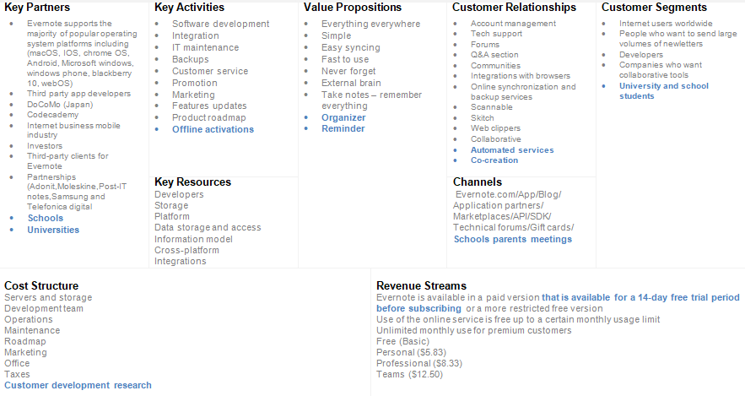
Evernote’s Proposed Business model

Slide 19
Evernote’s Proposed Pricing model
We suggest that Evernote’s pricing model to stay as is but with some modifications as follows
For each paid plan, the user to get a 14-day trial period so that users make their decisions based on their desirability to pay for the product
Users to get the free trial period without having to enter their payment details as this hinders the subscription process as many people tend to not to subscribe to any service just to skip adding their payment cards details
Add another paid plan for corporates as one of our proposed solutions regarding segmentation is to include schools and universities, accordingly having a pricing plan for large institutions or partnerships is a must

Slide 20
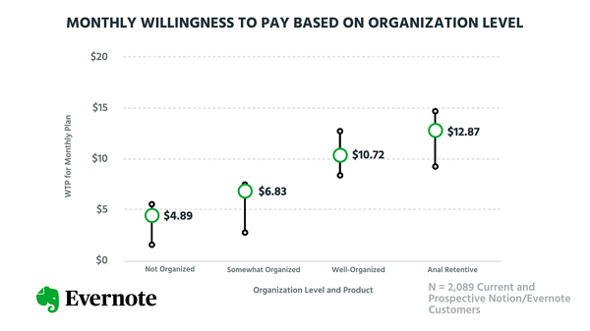
Evernote’s Proposed Pricing model (Cont.)
Introduce the logic of discounts based on the users usages and personas
I.e, researches proved that the more organized the user, the more increasing the willingness to pay for Evernote. Accordingly if Evernote followed the concept of offering promo-codes for their returning customers, this would lead to increasing number of returning customers, increasing usage rates and accordingly increase in company’s revenues.

Slide 21
Evernote’s Proposed Business Strategy
Mission:
Just a few clicks to help you get everything organized, and get everything in one place.
Vision:
World’s leading tech based company for documents organizing, projects management and business planning
Values:
Accountability, Customer obsession, Improvisation and Trustworthy,P
Competitive Advantage:
Hassle free projects planning! A whole project management tool is in the user’s pocket, few clicks to get the whole job done!
Strategic Objectives:
Market segmentation,Product market fit and deliver the value customers expect from a note-taking app.
Short-term goals:
Security and privacy , meet customer's requirement,Committing to fixing and improving the core Evernote product

Slide 22
Evernote’s Changes Needed
Continuous improvement and more investment in the product core version
Changes mindset of how we develop and deliver software
Make improvements to the core of application infrastructure
Change Pricing Model plan
Committing to fixing and improving the core Evernote product.
Fix technical issues
Sync unlimited devices
Get offline access on mobile and desktop

Slide 23
Evernote’s Proposed Solution
Security & Privacy
Enhancement New features like Voice recognitions
A note-taking tool for networked thought
Enhancement of creating structured and linked content easily
Enhancement in write, sharing, and searching speed
Implement Two way authentication
Implement Photos encryption

Slide 24
Evernote’s New Era - Email
Dears,
Evernote is witnessing a new promising era.
We are excited to share with you our upcoming surpassing product plan and releases.
What makes the impending releases different, is that we will be working on increasing our customer base, boosting our returning customers numbers, magnifying users engagement rates and decreasing the churn rates!
This won't be an easy phase, however it's worth the effort; specially that we are certain of its success!
Here is a glimpse of our upcoming product plans:
Improving the quality of the conducted researches regarding Evernote product market fit
Revisiting the following: Evernote segmentation, business model canvas and pricing model
Evernote for students: A new version that is dedicated to school and university students with specific features for studying and lectures attending!
Introducing a freemium model that precedes any subscription pricing plan with no credit card details required, for better and more satisfying user experience.
And much more…This is just the beginning!
We can’t wait to walk you all through our upcoming releases!
Sincerely,
Evernote Product Team
Notes:
https://evernote.com/intl/en/why-evernote
https://evernote.com/compare-plans
https://evernote.com/blog/new-features-plans-for-personal-professional-productivity/
https://www.profitwell.com/recur/all/evernote-tradeoffs
https://nira.com/evernote-history/
https://nira.com/wp-content/uploads/2019/03/evernote-food-discontinued-august-2015-official-forum-post.png
https://nira.com/evernote-history/
https://nira.com/wp-content/uploads/2019/03/evernote-food-discontinued-august-2015-official-forum-post.png
https://www.quora.com/What-are-the-biggest-problems-you-face-in-using-Evernote
https://www.cloudwards.net/best-note-taking-apps/
https://medium.datadriveninvestor.com/evernote-was-losing-its-market-share-but-7778ac051611
https://vizologi.com/business-strategy-canvas/evernote-business-model-canvas/
https://vizologi.com/vizo-4-0/business-strategy-canvas/evernote-business-model-canvas/
https://www.cloudwards.net/best-note-taking-apps/
https://evernote.com/community/referral/?ebcc=ebcc-anshulkumar3743&gspk=ZWJjYy1hbnNodWxrdW1hcjM3NDM&gsxid=9Zf31lenbY8F
https://www.getapp.com/collaboration-software/a/microsoft-onenote/compare/zoho-notebook-vs-evernote-vs-google-keep/
https://www.cloudwards.net/best-note-taking-apps/
https://www.g2.com/compare/evernote-vs-google-workspace-vs-microsoft-onenote-vs-zoho-notebook
https://sensortower.com/android/US/evernote-corporation/app/evernote-notes-organizer-daily-planner/com.evernote/overview
https://www.youtube.com/watch?v=KBnyayE9Kn0

